Slide 1
Model selection with
SOC
What VIF means?
Dropping more features
SVR with rbf kernel hyperparameters
Results

Slide 2
Variance inflation factor (VIF) (from statsmodels library)
For i in [0, #features-1] run Ordinary Least Squares (OLS) method with i^{th} feature and rest
Calculate r2 score [0, 1]
VIF = 1/(1-r2 score), ranges in [1,inf)
r2_score represents the proportion of variance (of y) that has been explained by the independent variables in the model. It provides an indication of goodness of fit and therefore a measure of how well unseen samples are likely to be predicted by the model, through the proportion of explained variance.[1]
Strategy: drop single feature with highest VIF > 10 at a time, repeat until no feature with VIF > 10 is left
r2 | 0 | 0.1 | 0.2 | 0.3 | 0.4 | 0.8 | 0.9 | 0.999 | 1
VIF | 1 | 1.1 | 1.25 | 1.42 | 1.66 | 5 | 10 | 1000 | inf

Slide 3
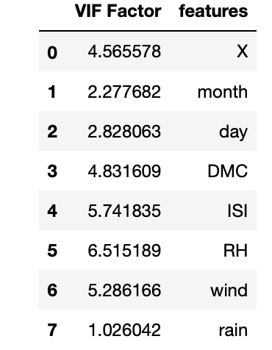
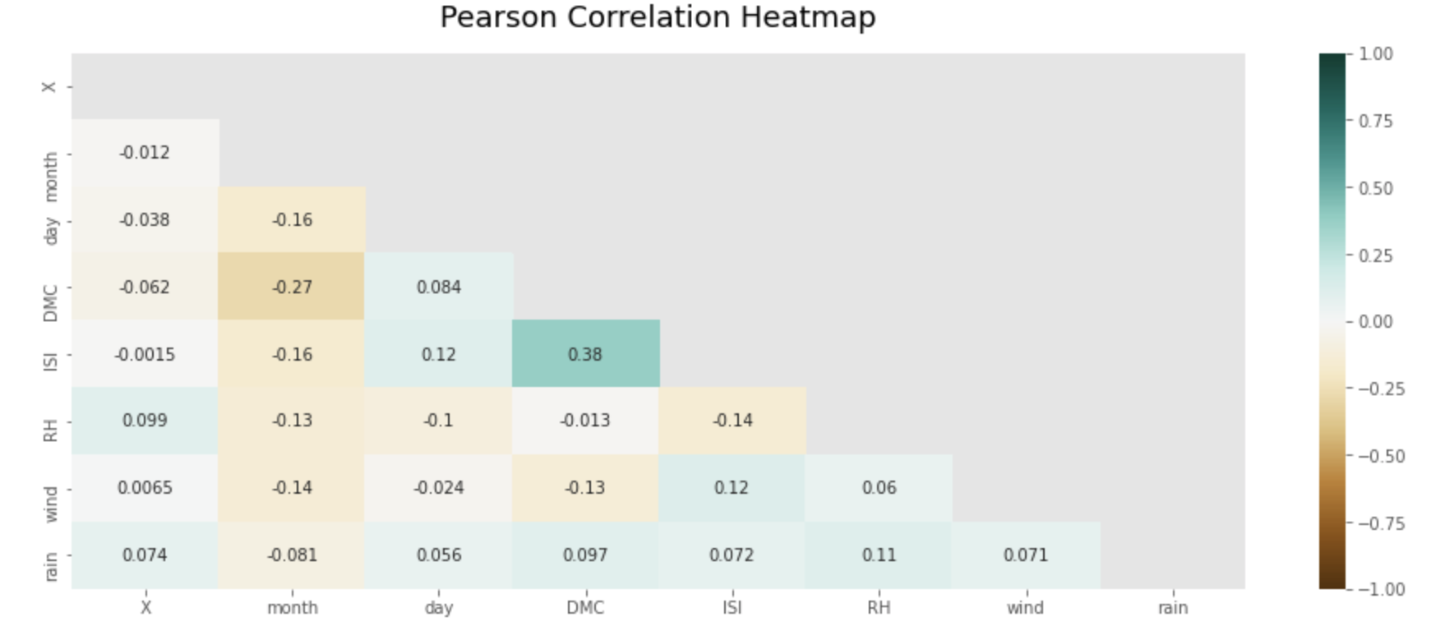
Forest Fire without standard scaler after dropping features
MSE | SOC | 13.65 | 10700
MAE | SOC | 2.1880 | 10170
Best error rates

Slide 4
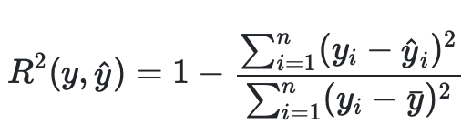
How VIF is calculated (e.g. for DMC )?
Let y = DMC
Let X = [X, month, day,ISI, RH, wind, rain]
y_pred = OLS(X,y)
VIF = 1/(1-0.793) = 4.83
= 0.793

Slide 5
Dropping more features (to reduce SOC,e.g. RH)
SOC: 9042
MSE: 14.446

Slide 6
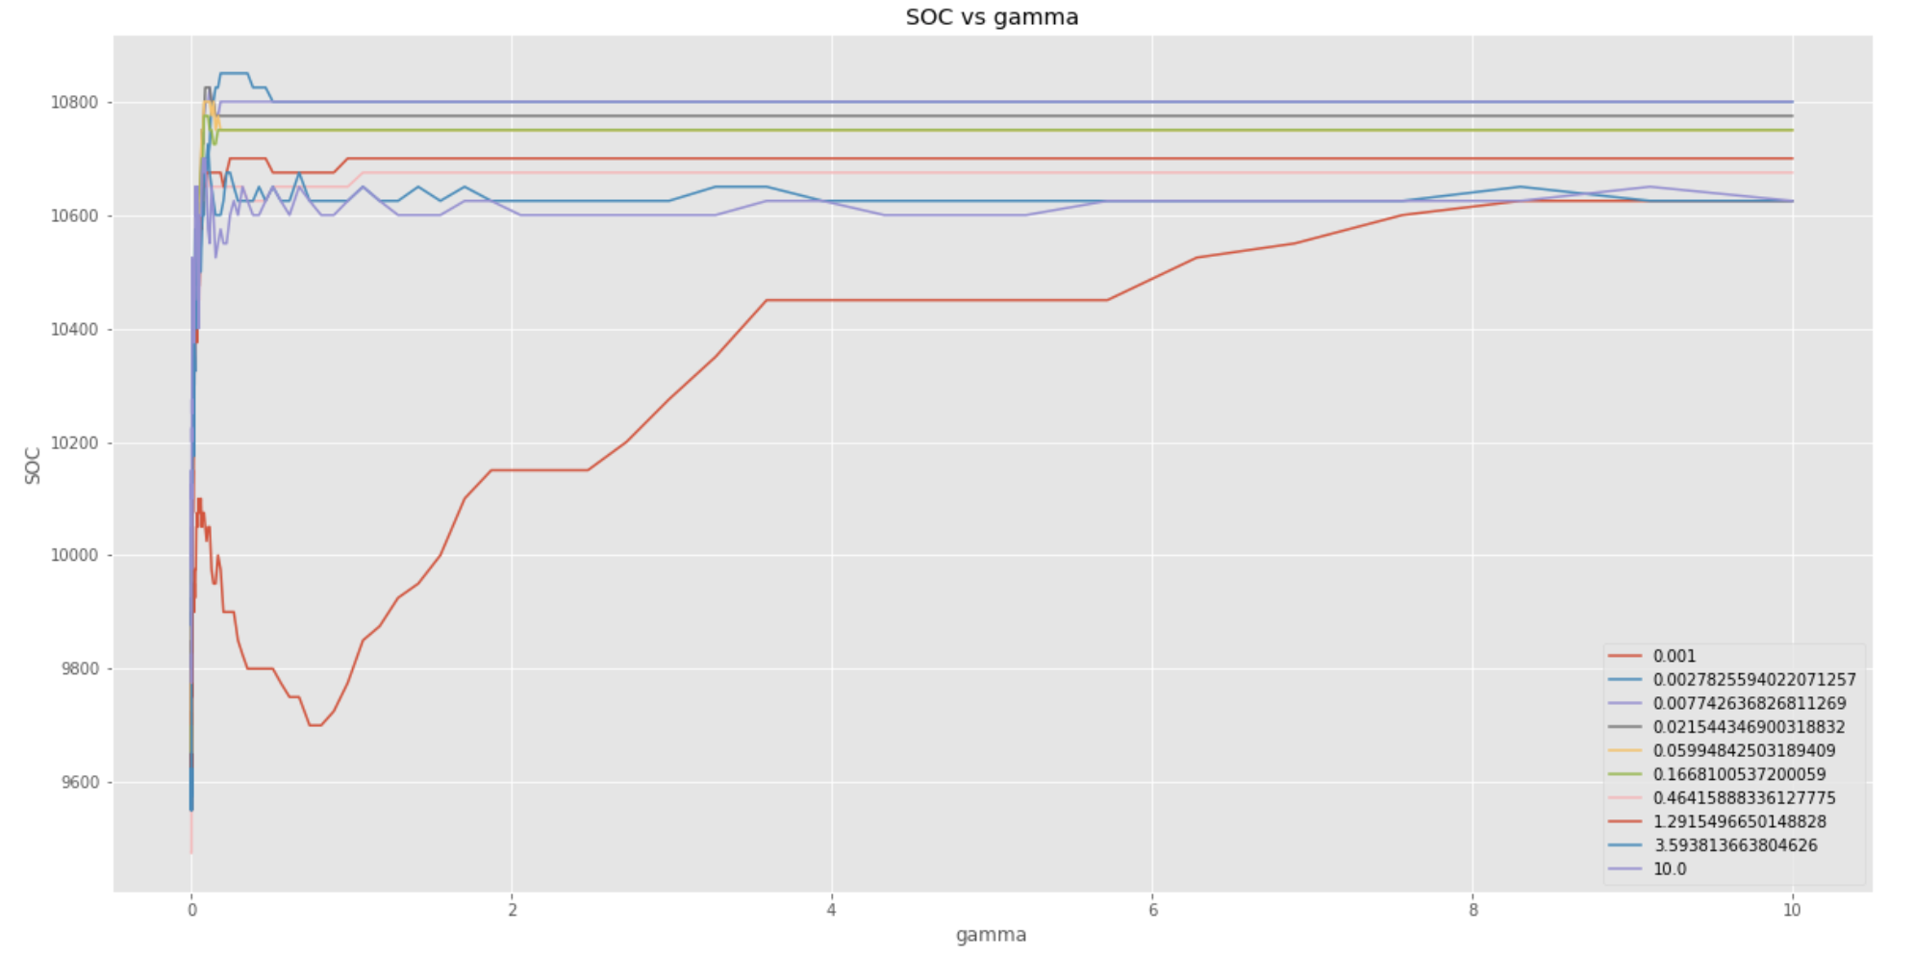
SVR with rbf kernel hyperparameters

